Slide 1
Customize comparison tables for clinical studies
Polina Kukhareva, University of Utah, Salt Lake City, UT
Kathy Roggenkamp, Collaborative Studies Coordinating Center, UNC, Chapel Hill, NC

Slide 2
Outline
Baseline Characteristics
Calling the macro to produce a raw table
Descriptive statistics and p-values
Customizing a table

Slide 3
Introduction
Although the eligibility criteria indicate who was eligible for the trial, it is also important to know the characteristics of the participants who were actually included. This information allows readers, especially clinicians, to judge how relevant the results of a trial might be to an individual patient.
http://www.consort-statement.org/consort-statement/

Slide 4
Introduction
Baseline Characteristics
Demographics
Clinical
Blood pressure
Body Mass Index
Age
Gender

Slide 5
Producing baseline characteristics tables:
Time-consuming
Repetitive
Easy to make a mistake
Hard to make changes

Slide 6
Solution: write a SAS macro
What is the SAS Macro?
SAS macro is a piece of SAS code which could inserted into your program.
You can slightly change this code by changing the macro parameters.

Slide 7
Objectives
1. Describe a macro which:
creates a table of descriptive statistics of sample characteristics across the group categories
estimates correct p-values for categorical, countable, and continuous variables
prints this table into an RTF file and into a new SAS data set

Slide 8
Objectives
2. Describe post-processing code which
creates a report containing only specific lines
uses new format for p-values, new report style, new titles and footnotes
uses in-line formatting to change fonts in the labels

Slide 9
Simulated Cardiovascular Dataset
Predictors
Categorical
diabetes
smoking
sex
treatment group
activity (‘low’, ‘high’, ‘average’)
Continuous
age
systolic_bp
diastolic_bp
ldl
bmi
Response
Occurrence
CV_event
CV_time
Timing
Notes:
To begin with I created a simulated data set which I could share with everybody.

Slide 10
Macro parameters
Parameter | Example
Required Parameters
_DATA_IN |  | rq.simcox
_DATA_OUT |  | data_out1
_GROUP |  | treatment
_CHARACTERISTICS |  | age systolic_bp diastolic_bp ldl bmi diabetes smoking sex
Optional Parameters
_CATEGORICAL=_no_categorical_variables |  | diabetes smoking sex treatment activity
_COUNTABLE=_no_countable_variables |  | ldl
_FOOTNOTE= |  | %str(&sysdate, &systime -- produced by macro Compare_baseline_characteristics)
_TITLE1= |  | Compare_baseline_characteristics Macro
_NUMBER= |  | bc_macro_1
Notes:
Optional parameters have a default value. Don’t use them if you don’t need them!

Slide 11
Example 1: Calling the macro
%Compare_baseline_characteristics(
_DATA_IN=rq.simcox,
_DATA_OUT=data_out1,
_GROUP=treatment,
_CHARACTERISTICS= age ldl bmi diabetes smoking sex activity CV_event,
_CATEGORICAL=smoking sex treatment activity CV_event,
_COUNTABLE=ldl)

Slide 12
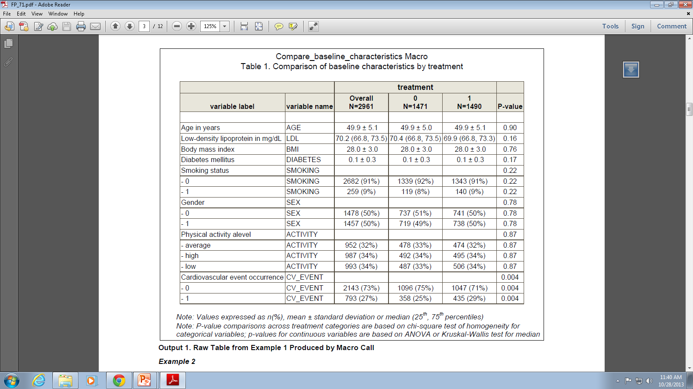

Slide 13
Descriptive statistics used
Values expressed as :
n(%)
mean ± standard deviation
median (25th, 75th percentiles)
Mean | Median
Normal Distribution | Skewed distribution, scores or extreme values
Example: In the research lab 5 graduate students earn 20K and one PI earn 200K.
Mean = 300/6=50K
Median = 20 K

Slide 14
Statistical tests: χ²
P-value comparisons across treatment categories are based on chi-square test of homogeneity of proportions for categorical variables
Null hypothesis: different populations have the same proportion of individuals with some characteristic
Assumptions:
• The data are randomly selected
• All expected frequencies are greater than or equal to 1 (i.e., Ei>1.)
• No more than 20% of the expected frequencies are less than 5

Slide 15
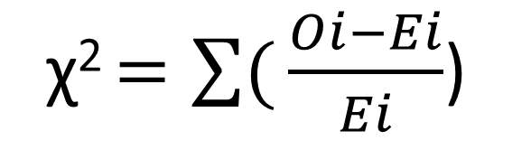
Statistical tests: χ²
χ² $=\sum{(}\frac{Oi−Ei}{Ei}$)
 | Treatment=0 | Treatment=1 | Raw Total
Smoking status=0 | 1339 | 1342 | 2682
Smoking status=1 | 119 | 140 | 259
Column Total | 1471 | 1490 | 2961
/*getting p-values*/
proc freq data=baseline_characteristics_ds;
table categorical_group*&CHECK_VAR/chisq;
output out=p pchi;
run;

Slide 16
Statistical tests used
P-values for continuous variables are based on ANOVA
Null hypothesis: the means of the groups are equal
Assumptions:
• Independence of observations
• Normality – the distributions of the residuals are normal
• homogeneity of variances— the variance of data in groups should be the same
ods output OverallANOVA=p(keep= dependent source probf where=(source='Model')
rename=(probf=pvalue dependent=variable));
proc anova data=baseline_characteristics_ds;
class categorical_group;
model &CHECK_VAR=categorical_group;
run;
ods output close;

Slide 17
Statistical tests used
P-values for countable variables are based on Kruskal-Wallis test for median
Null hypothesis: the medians of the groups are equal
Assumptions:
• The continuous distributions for the test variable are exactly the same (except their medians) for the different populations.
• Independence of observations
proc npar1way data=baseline_characteristics_ds wilcoxon; var &CHECK_VAR;
class categorical_group;
output out=p Wilcoxon;
run;
Notes:
When working with a measurement variable, the Kruskal–Wallis test starts by substituting the rank in the overall data set for each measurement value. The smallest value gets a rank of 1, the second-smallest gets a rank of 2, etc. Tied observations get average ranks; thus if there were four identical values occupying the fifth, sixth, seventh and eighth smallest places, all would get a rank of 6.5.
The sum of the ranks is calculated for each group, then the test statistic, H, is calculated. H is given by a rather formidable formula that basically represents the variance of the ranks among groups, with an adjustment for the number of ties. H is approximately chi-square distributed, meaning that the probability of getting a particular value of H by chance, if the null hypothesis is true, is the P value corresponding to a chi-square equal to H; the degrees of freedom is the number of groups minus 1.
If the sample sizes are too small, H does not follow a chi-squared distribution very well, and the results of the test should be used with caution. N less than 5 in each group seems to be the accepted definition of "too small."

Slide 18
How does the macro work?
/*We are iterating through all the predictors with their treatment depending on their role*/
%do all_count=1 %to %sysfunc(countw(&_CHARACTERISTICS));

Slide 19
Example 2: Calling the macro
%Compare_baseline_characteristics (_DATA_IN=rq.simcox, _DATA_OUT=data_out2,
_GROUP=activity,
_CHARACTERISTICS= age ldl bmi smoking sex treatment,
_CATEGORICAL=smoking sex treatment activity,
_COUNTABLE=ldl)

Slide 20
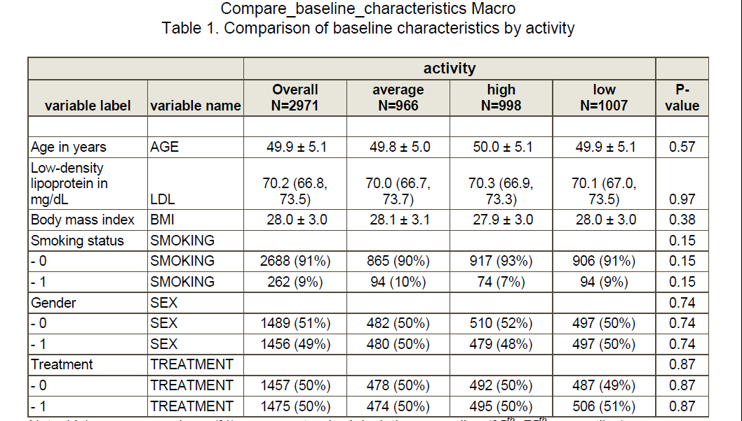
Notes:
That’s why we used ANOVA instead of T-test and Kruscal-Wallis instead of Wilcoxon-Mann-Whitney test.

Slide 21
Customizing a table
Column 1 | variable name | Column 2 | variable label | Column 3
if variable=" | AGE | " and label=" | Age in years | " then do; characteristic="{\i \ul Baseline Characteristics\line \line \ul0 \i0 &c Age (yr)}"; order=1; end;
if variable=" | LDL | " and label=" | Low-density lipoprotein in mg/dL | " then do; characteristic="{&c LDL cholesterol (mg/dL), median (25\super th}{, 75\super th }{)}"; order=9; end;
if variable=" | BMI | " and label=" | Body mass index | " then do; characteristic="{&c Body mass index (kg/m)}"; order=2; end;
if variable=" | SMOKING | " and label=" | - 1 | " then do; characteristic="&c Currently smoking"; order=3; end;
if variable=" | SEX | " and label=" | - 0 | " then do; characteristic="&c Women"; order=4; end;

Slide 22
Customizing a table
Column 1 | variable name | Column 2 | variable label | Column 3
if variable=" | ACTIVITY | " and label=" | Physical activity alevel | " then do; characteristic="&c Exercise level" order=5; end;
if variable=" | ACTIVITY | " and label=" | - average | " then do; characteristic="{&c&c&c Average}"; order=6; pvalue=.; end;
if variable=" | ACTIVITY | " and label=" | - high | " then do; characteristic="{&c&c&c High}"; order=7; pvalue=.; end;
if variable=" | ACTIVITY | " and label=" | - low | " then do; characteristic="{&c&c&c Low}"; order=8; pvalue=.; end;
if variable=" | CV_EVENT | " and label=" | - 1 | " then do; characteristic"{\i \ul Outcome\line \line \ul0 \i0 &c Cardiovascular Event Occurrence}"; order=10; end;

Slide 23
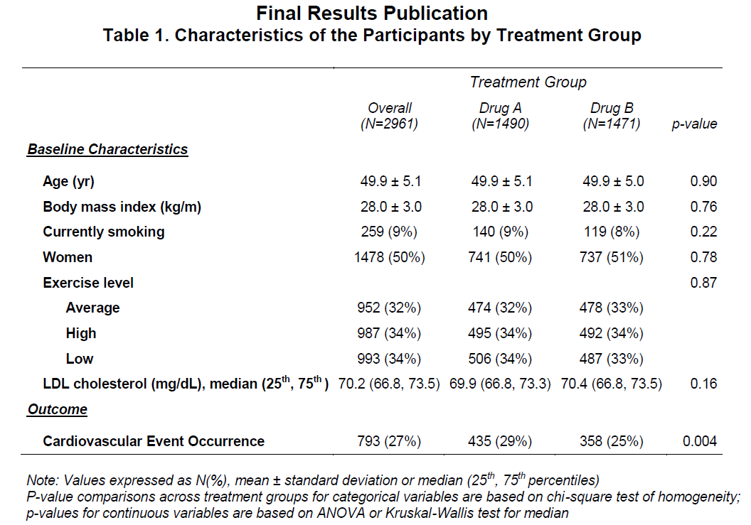

Slide 24
Customization: Inline formatting
ODS ESCAPECHAR= 'escape-character';
“\i makes” - the subsequent text appear in italic
“\line” - inserts a line break
“\UL” - starts the underlining
“\UL0” - stops the underlining
“SUB” - arguments to subscript
“SUPER” - arguments to superscript

Slide 25
Customization: use formats
proc format;
value pvalue2_best
0-<0.001='<0.001'
0.001-<0.005=[5.3]
0.005-<0.045= [5.2]
0.045-<0.055=[5.3]
other=[5.2];
run;

Slide 26
Proc Report
proc report data=display nowd style=[cellpadding=6 font_size=8.5 pt rules=none];
column order characteristic('Treatment Group' column_overall column_2 column_1 pvalue);
define order / order noprint;
define characteristic / display " "
style=[just=left cellwidth=9.0 cm font_weight=bold font_size=8.5 pt];
define column_2 / display "{Drug A\line (N=&count_2)}" &st ;
define column_1 / display "{Drug B\line (N=&count_1)}" &st ;
define column_overall / display "{Overall\line (N=&count_overall)}" &st ;
define pvalue / display "{p-value}" format=pvalue2_best.
style(column)=[just=right cellwidth=2 cm vjust=bottom font_size=8.5 pt] style(header)=[just=right cellwidth=2 cm font_size=8.5 pt] ;
run;

Slide 28
Conclusion
Don’t be scared to start writing SAS macros yourself!
It gets better after awhile…
This two-step strategy allows producing comparison tables that comply with journal requirements.
The customization ideas might be helpful if slight changes are needed in existing reports.

Slide 29
Acknowledgment
Thanks to Kathy Roggenkamp, my coauthor
Thanks to our colleagues at the Collaborative Studies Coordinating Center: Myra Carpenter, Stephen Campbell, and Kwanhye Jung.

Slide 30
Name: Polina Kukhareva
Enterprise: University of Utah
Address: 615 Arapeen Dr., Suite 208
City, State ZIP: Salt Lake City, UT, 84108
Work Phone: (801) 587-8001
Fax: (801) 585-1652
E-mail: Polina.Kukhareva@utah.edu

